Slide 1
Azure IoT Edge

Slide 2
IoT in the Cloud and on the Edge
IoT in the Cloud
Remote monitoring and management
Merging remote data from multiple IoT devices
Infinite compute and storage to train machine learning and other advanced AI tools
IoT on the Edge
Low latency tight control loops require near real-time response
Protocol translation & data normalization
Privacy of data and protection of IP
Symmetry

Slide 3
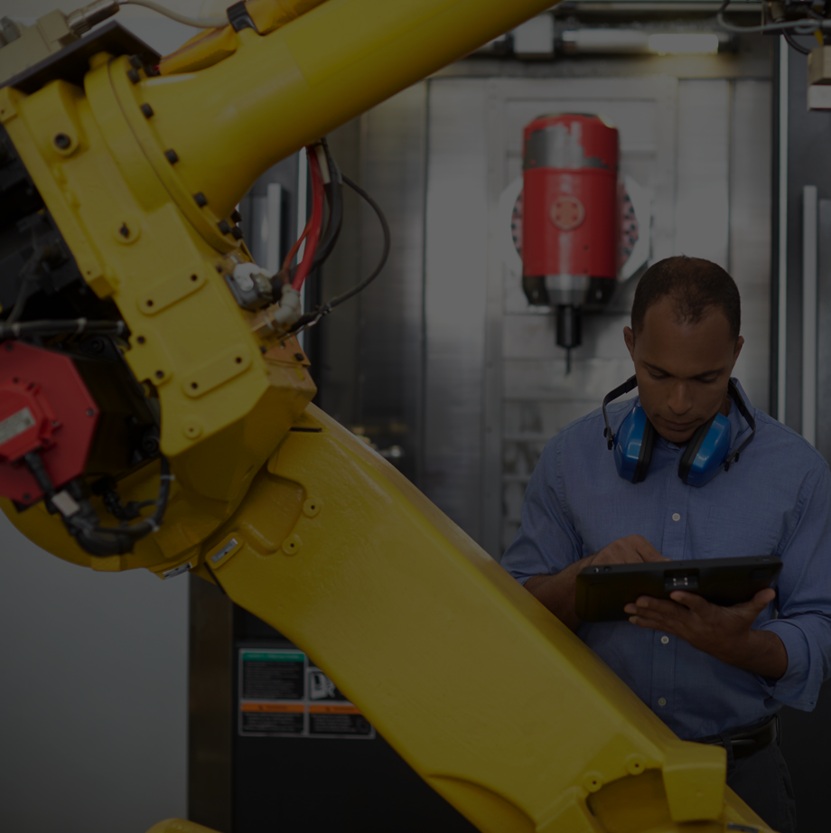
Move cloud and custom workloads to the edge, securely
Seamless deployment of AI and advanced analytics
Azure IoT Edge
Configure, update and monitor from the cloud
Compatible with popular operating systems
Code symmetry between cloud and edge for easy development and testing
Secure solution from chipset to cloud
Notes:
Secure
Provides a secure connection to the Azure IoT Edge, update software/firmware/configuration remotely, collect state and telemetry and monitor security of the device
Cloud managed
Enables rich management of Azure IoT Edge from Azure provide a complete solution instead of just an SDK
Cross-platform
Enables Azure IoT Edge to target the most popular edge operating systems, such as Windows and Linux
Portable
Enables Dev/Test of edge workloads in the cloud with later deployment to the edge as part of a continuous integration / continuous deployment pipeline
Extensible
Enables seamless deployment of advanced capabilities such as AI from Microsoft, and any third party, today and tomorrow
Simplifies the development process and makes it easy and fast for customers to get started, making digital transformation more accessible to everyone.
Available along with our existing platform-as-a-service (PaaS) solution, Azure IoT Suite, which enables deep customization and full control.

Slide 4
IoT architecture requirements
Handle extreme hardware and software heterogeneity.
Lower barriers to entry: evaluate -> prototype -> deploy.
Provide hot-path and cold-path analysis and response.
Build for hyper-scale and enable low latency.
Be secure by design; support defense in depth.

Slide 5
Pattern: Telemetry first
Start with telemetry.
The important data may not be what you expected.
Address privacy, security and manageability before moving to command and control.
It is very hard to predict in advance what data will be useful.
It is tempting, but likely inefficient to try for business transformation in the first step.
Think about not only device telemetry but also diagnostic telemetry.
Privacy and security implications of telemetry are generally lesser than for command and control.

Slide 6
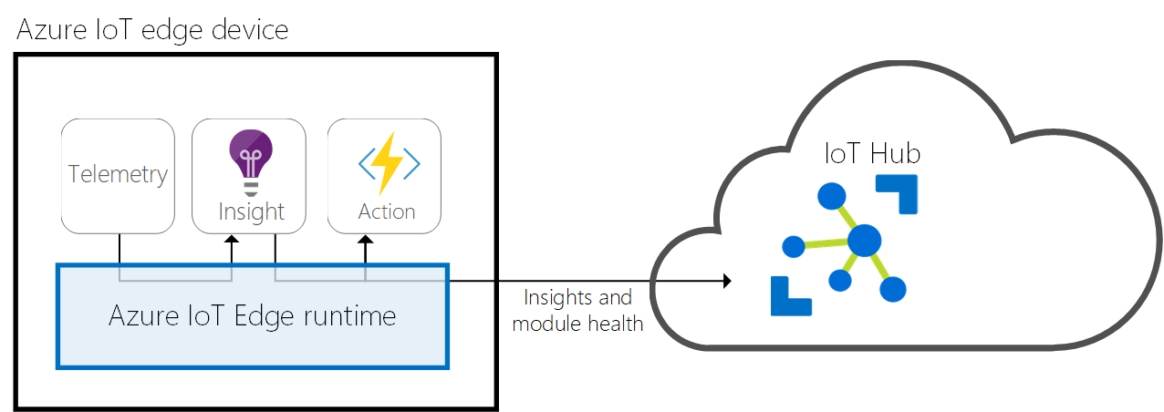
Concept – Azure IoT Edge Runtime
Installs and updates workloads on the device.
Maintains Azure IoT Edge security standards on the device.
Ensures that IoT Edge modules are always running.
Reports module health to the cloud for remote monitoring.
Facilitates communication between downstream leaf devices and the IoT Edge device.
Facilitates communication between modules on the IoT Edge device.
Facilitates communication between the IoT Edge device and the cloud

Slide 7


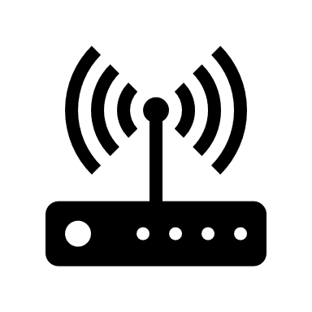



IoT Edge in action
Container based workloads
AI Services
Azure Functions
Azure Stream Analytics
Azure Machine Learning
Your own code using module SDK
1 – Edge device provisioned with right agents for scenario
IoT Hub
2 – Select Edge node to deploy to
3 – Define modules on Edge node via device twin
Container Modules
Module Twin
Device Twin
IoT Edge operator
4 – Define message routes for modules on edge node via device twin
5 – Define Module twins for module configurations (parameters)
IoT Edge
Container
Module
Container
Module
Container
Module
Container
Module
Edge device with security requirements
Rich OS – Linux or Windows
Docker-compatible container management system
Connects to Edge Hub (Owns a device twin)
IoT Device with IoT Device SDK
Module Twin
Device Twin
Module
Routes
Edge runtime
IoT Device (e.g. BLE)
Connects to BLE Module for protocol translation (configured via BLE Module twin)
Local storage
Device Provisioning
Security Manager
Secure Boot
Secure Storage
Hardware based root of trust

Slide 8
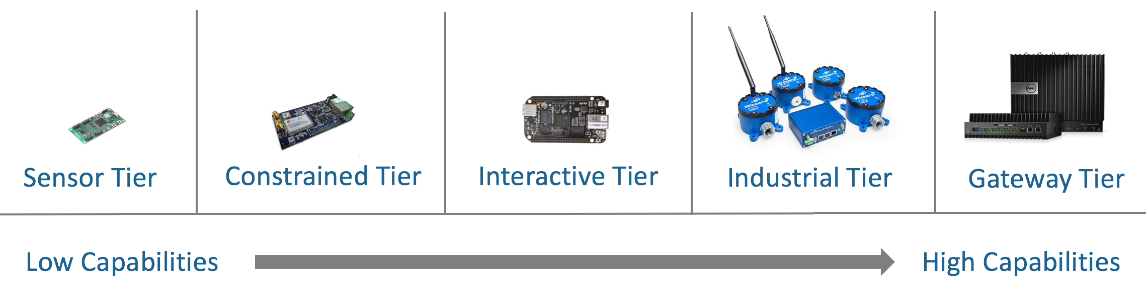
Hardware for Azure IoT Edge
Ability to run on devices smaller than a Raspberry Pi
128MB memory
Support best in class operating systems such as Windows, and Linux

Slide 9
Industrial Automation Primer
Cloud or On-Premise Services
OPC UA Pub/Sub
Enterprise Resource Planning (ERP) System ~ 1 per factory
(Capacity Planning, Ordering, Inventory)
OPC UA is often used
Manufacturing Execution System (MES) ~ 1 per line
(Supervisory Control and Data Access (SCADA))
OPC Classic, OPC UA, MTConnect, DDS, PLCOpen, …
Programmable Logic Controllers (PLCs) ~ 1 per station
Modbus, EtherCAT, ProfiNet, IO-Link, …
Sensors, Motors, Actuators ~ 1..n per component

Slide 10

The Industrial Interoperability Standard™
440 members, non-profit, board seats by:
Siemens
Honeywell
Unified Automation
(Rockwell) – OPCF CEO Tom Burke used to be CTO of Rockwell and they used to be on the board
SAP
Beckhoff
Iconics
(Schneider Electric) – OPCF CTO Jim Luth works for Schneider
Yokogawa
Microsoft

Slide 11
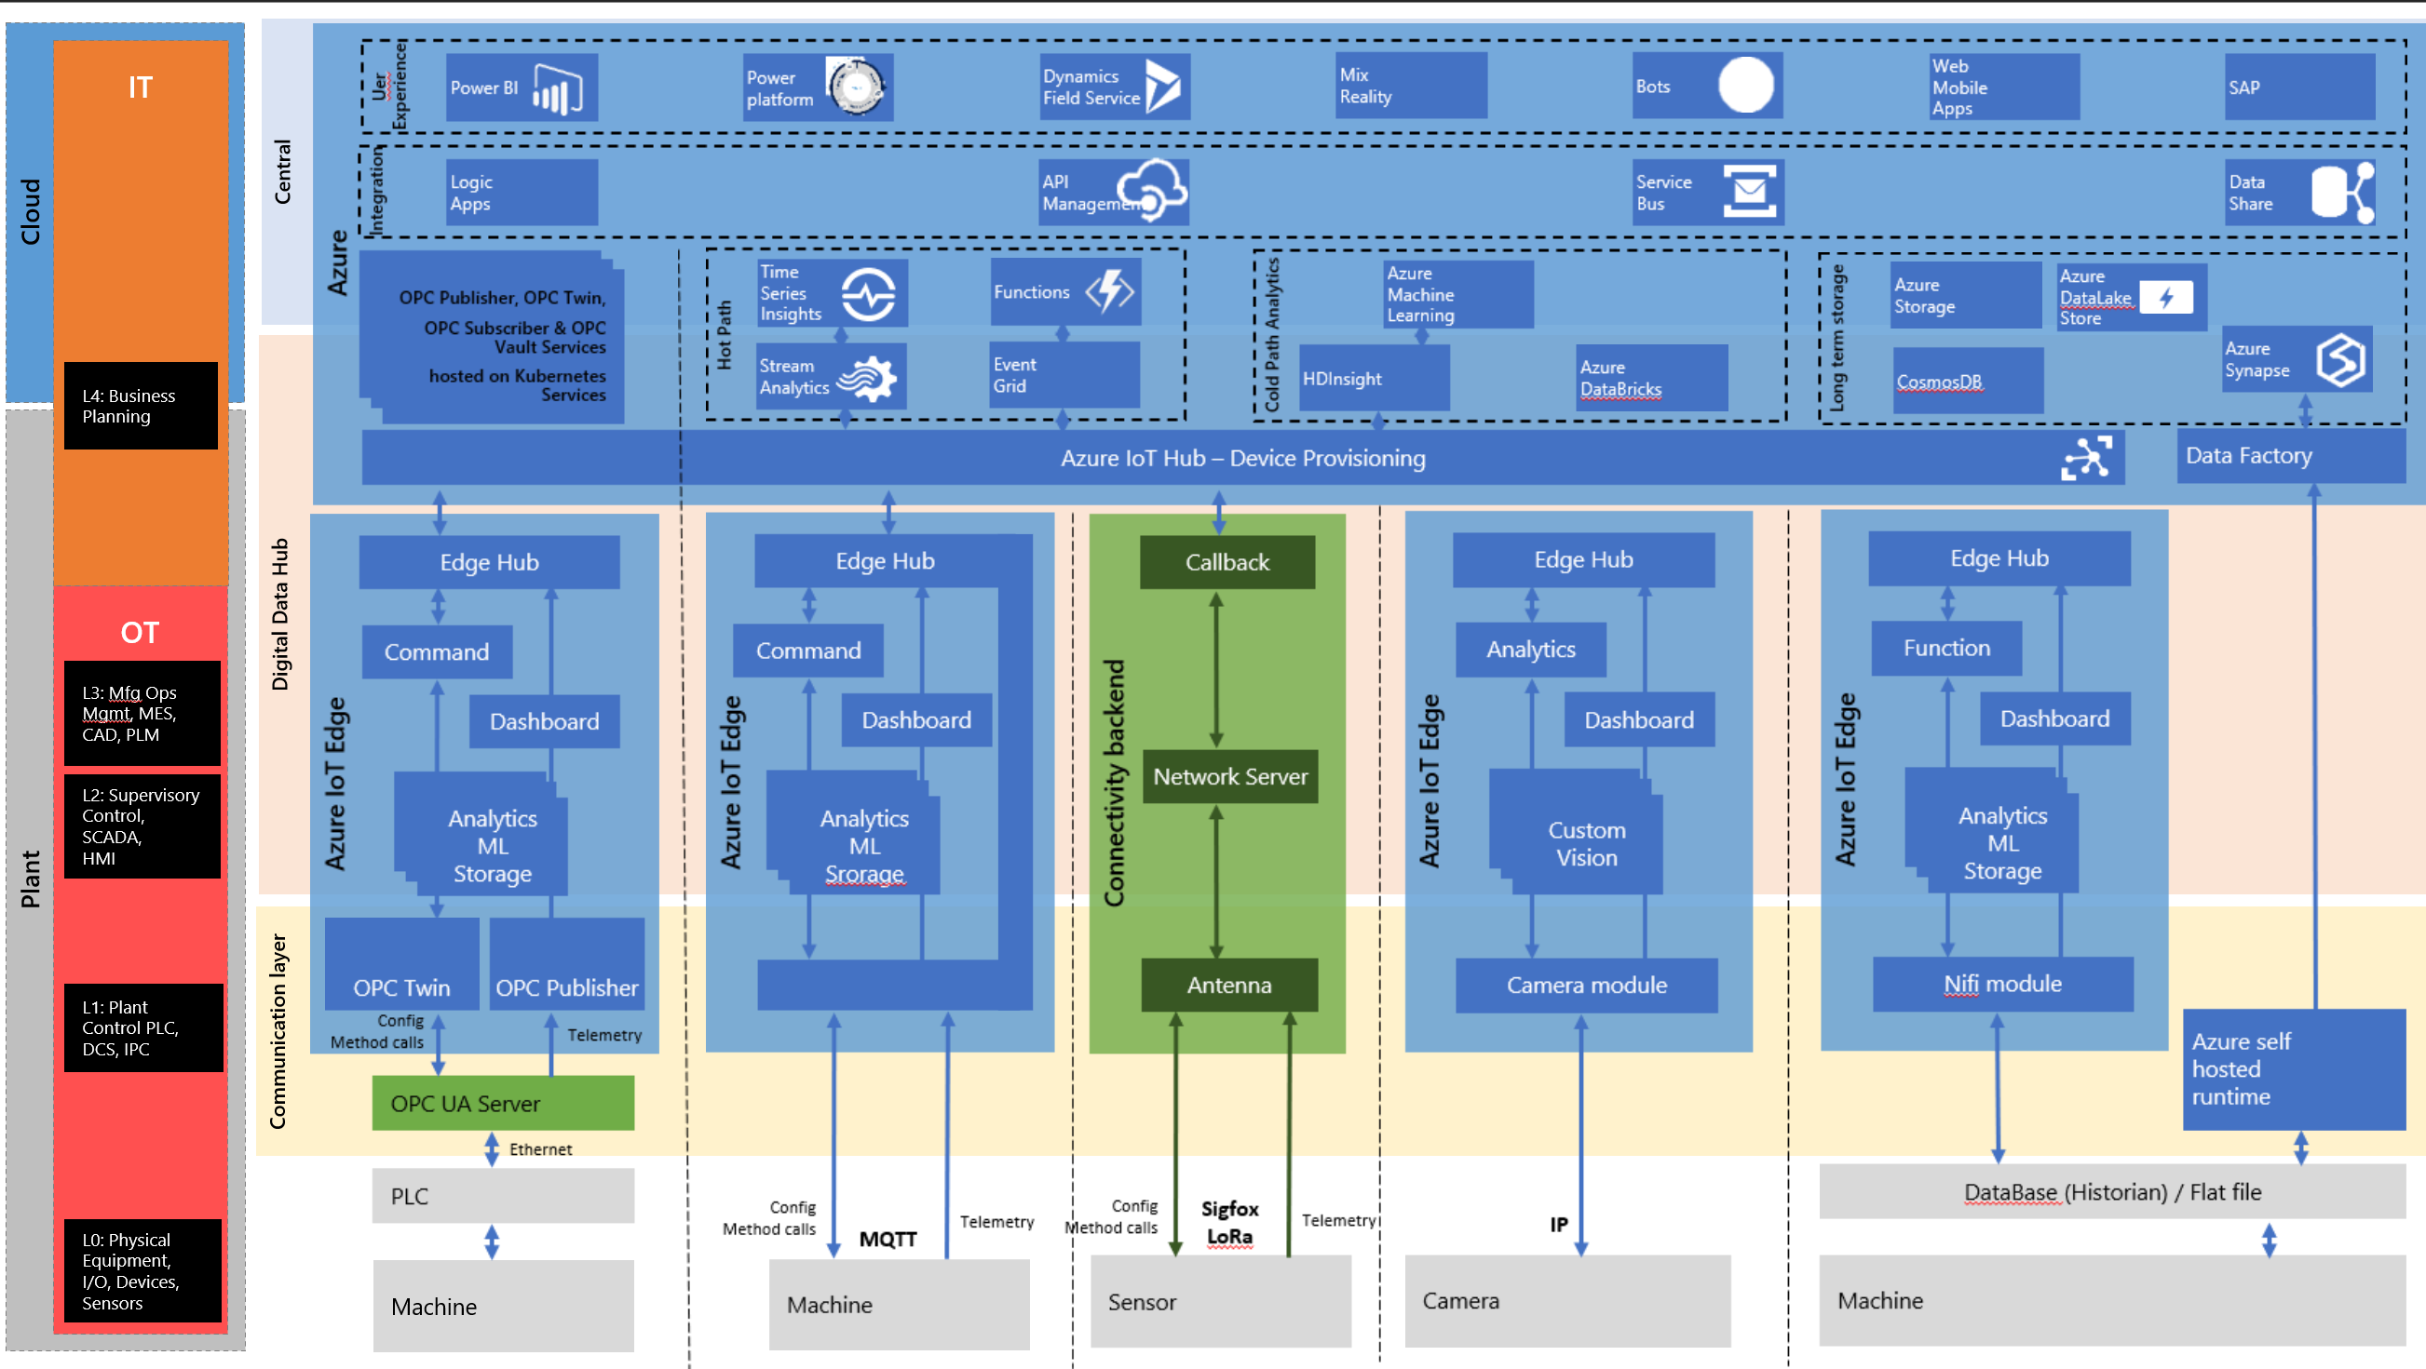

Slide 12

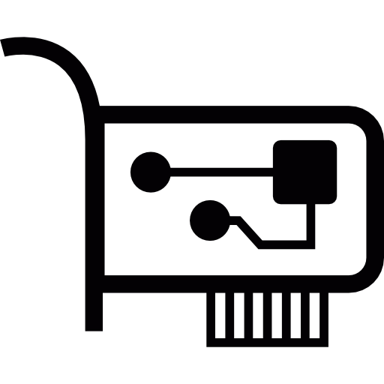
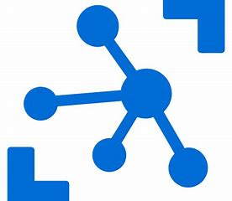

OT and IT networks segregation
Azure
IoT Edge Gateway Device
Protocol Module
Normalization
Module
ML Module
OT Network
edgeHub

Slide 13



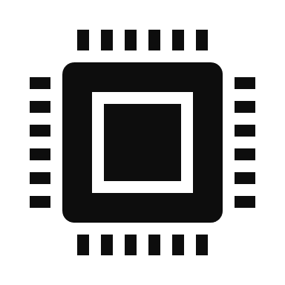
Disconnected scenarios
Azure
IoT Edge Gateway Device
Ingestion/
Processing module
Local storage module
HTTP endpoint
edgeHub

Slide 14
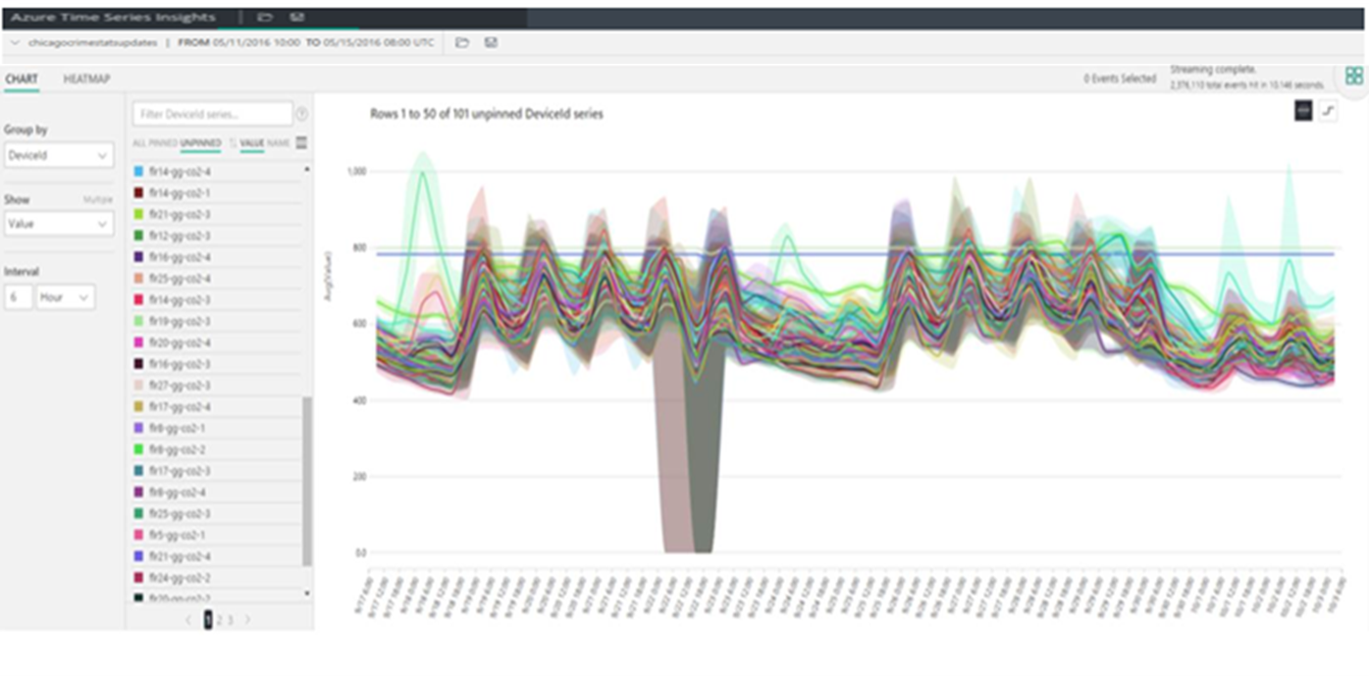
Azure Time Series Insights
Azure Time Series Insights is a fully managed analytics, storage, and visualization service that makes it incredibly simple to explore and analyze billions of events simultaneously.
Get near real-time insights in seconds
Start in seconds, scale in minutes
Create a global view of your IoT-scale data
Leverage the power of Time Series Insights in your Apps and Solutions

Slide 15


Azure Time Series Insights Core Scenarios
IoT time series data visualization and analytics
IoT validation and monitoring
Unified view of multiple devices, plants, and data.
Root cause analysis and anomaly detection
Build custom applications using REST APIs

Slide 16
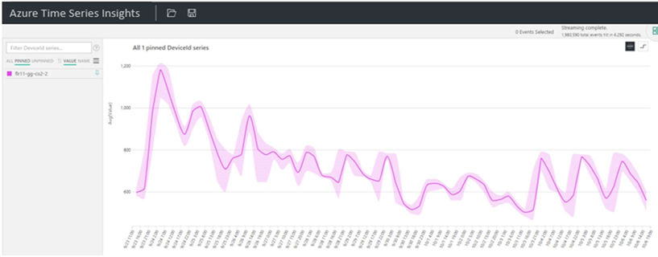
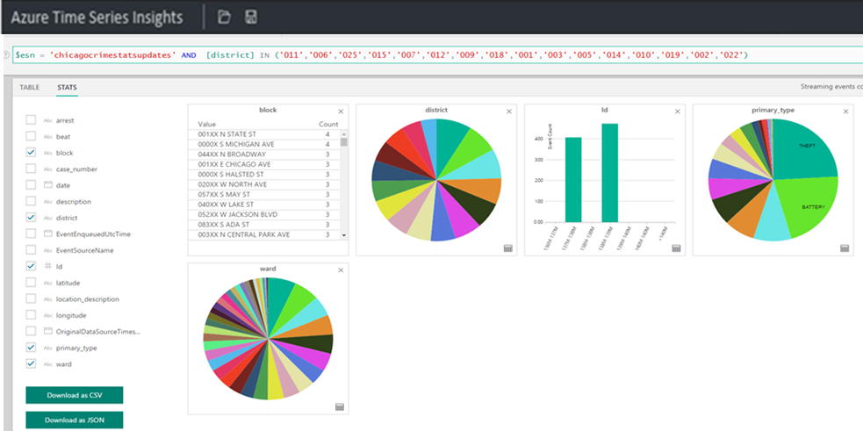
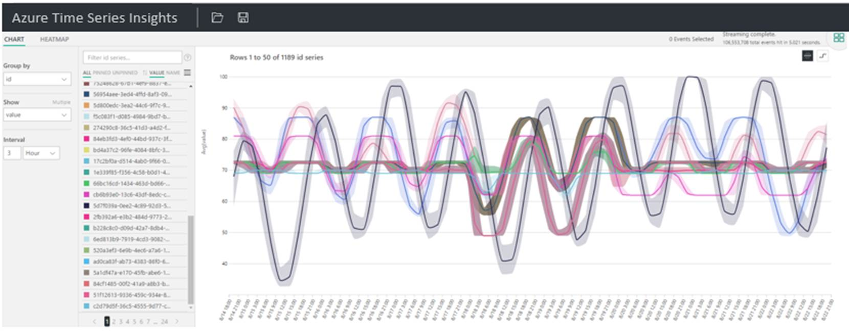
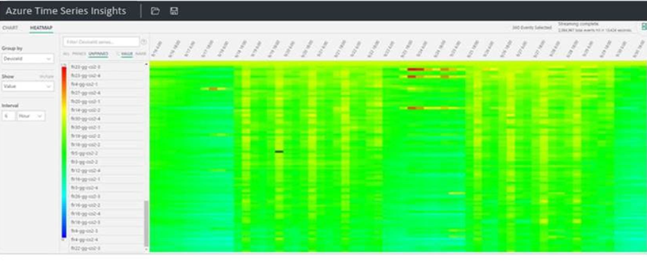
Azure Time Series Insights

